Slide 1

Data-Driven Insights from NYC Yellow Taxi Trips (2022)
Supporting revenue optimisation and service performance through comprehensive analysis of pickup patterns, fare structures, and tipping behaviours across all five boroughs.

Slide 2
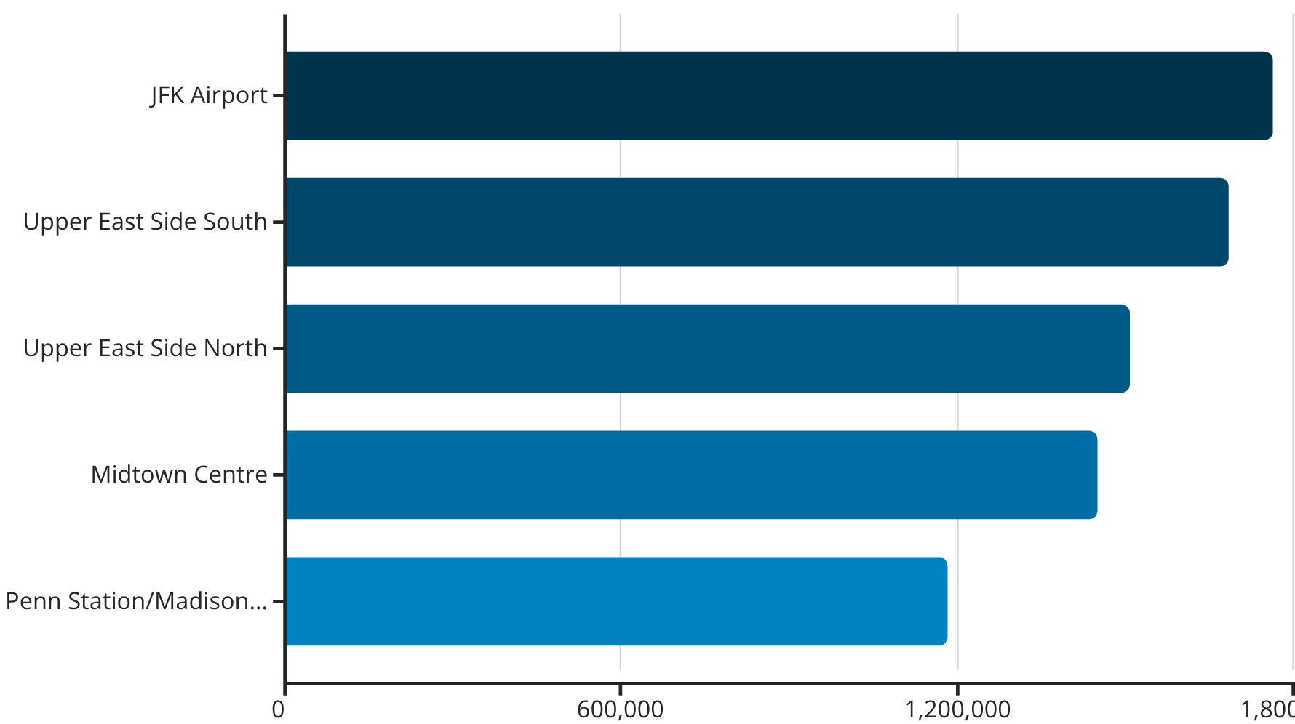
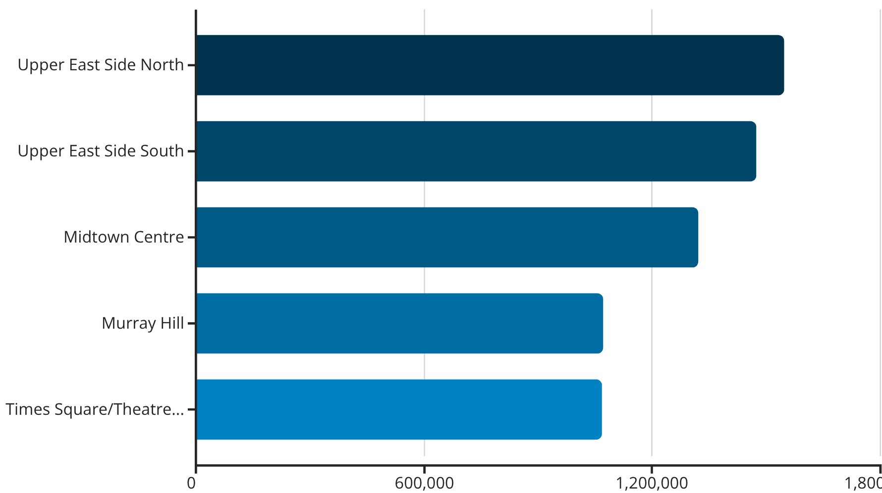
Top 5 Pickup and Drop-off Zones in 2022
Taxi demand is highly concentrated in the Upper East Side and Midtown, with JFK Airport as the dominant pickup hub. Upper East Side North and South appear in the top three for both pickups and drop-offs, reflecting dense residential and work activity alongside strong two-way demand.
Pickup Locations
Drop-off Locations
01
01
JFK Airport
Upper East Side North
Dominant hub driven by inbound travel demand
Top residential destination zone
02
02
Upper East Side South
Upper East Side South
Strong two-way passenger flow
Consistent inbound traffic patterns
03
03
Upper East Side North
Midtown Centre
Dense residential activity and high demand
Primary employment and leisure hub
04
04
Midtown Centre
Penn Station/Madison Sq West
Commercial and tourist hotspot
Major transport interchange
05
05
Penn Station/Madison Sq West
Times Square/Theatre District
Major transport interchange
Entertainment and tourism draw

Slide 3

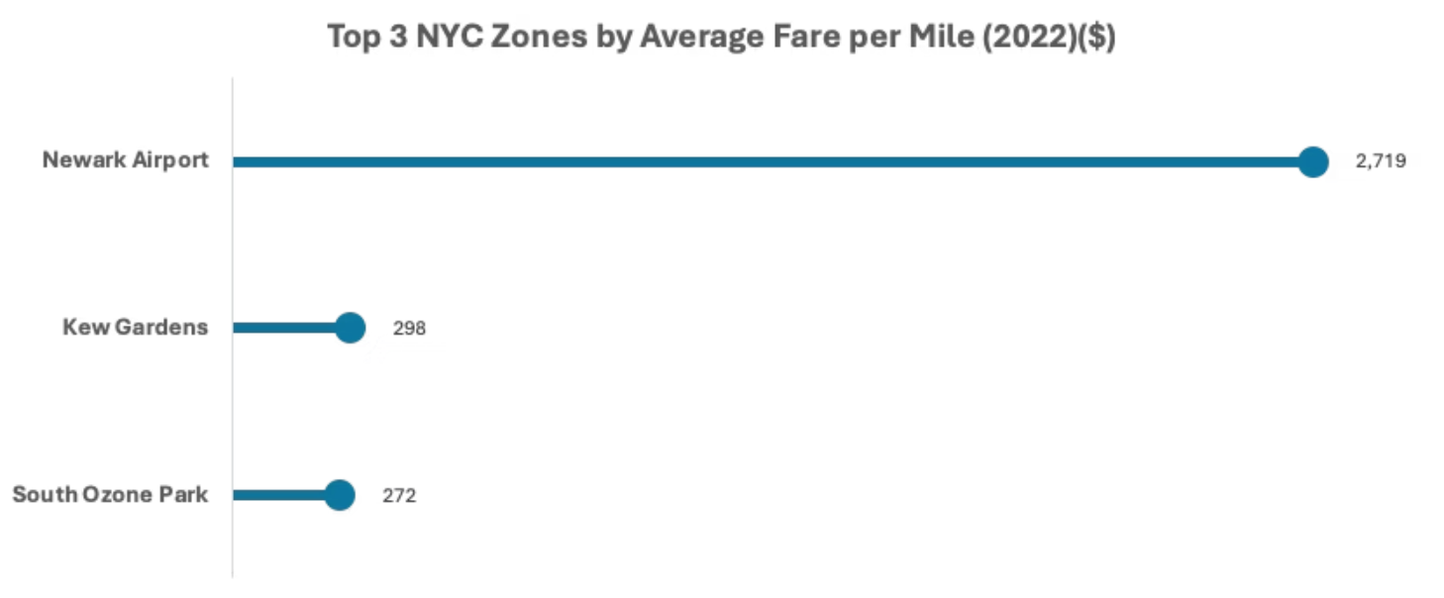




Fare-Per-Mile Anomalies
Newark Airport
Kew Gardens
Highest average fare per mile by far. The taxi metre only records distance inside NYC boundaries, whilst fares cover the full journey from New Jersey. This creates artificially inflated ratios.
This zone is adjacent to JFK Airport. Even short trips from here
incur airport surcharges, minimum fares, and congestion fees, significantly raising the fare relative to the recorded distance.
South Ozone Park
Similar to Kew Gardens, its proximity to JFK Airport means trips often include airport surcharges, minimum fares and congestion fees, which inflates
the per-mile calculation for short distances.
Key Insight: Understanding these data anomalies is essential for accurate pricing analysis and operational planning. The Newark Airport effect demonstrates how geographic boundaries can distort distance-based metrics.

Slide 4

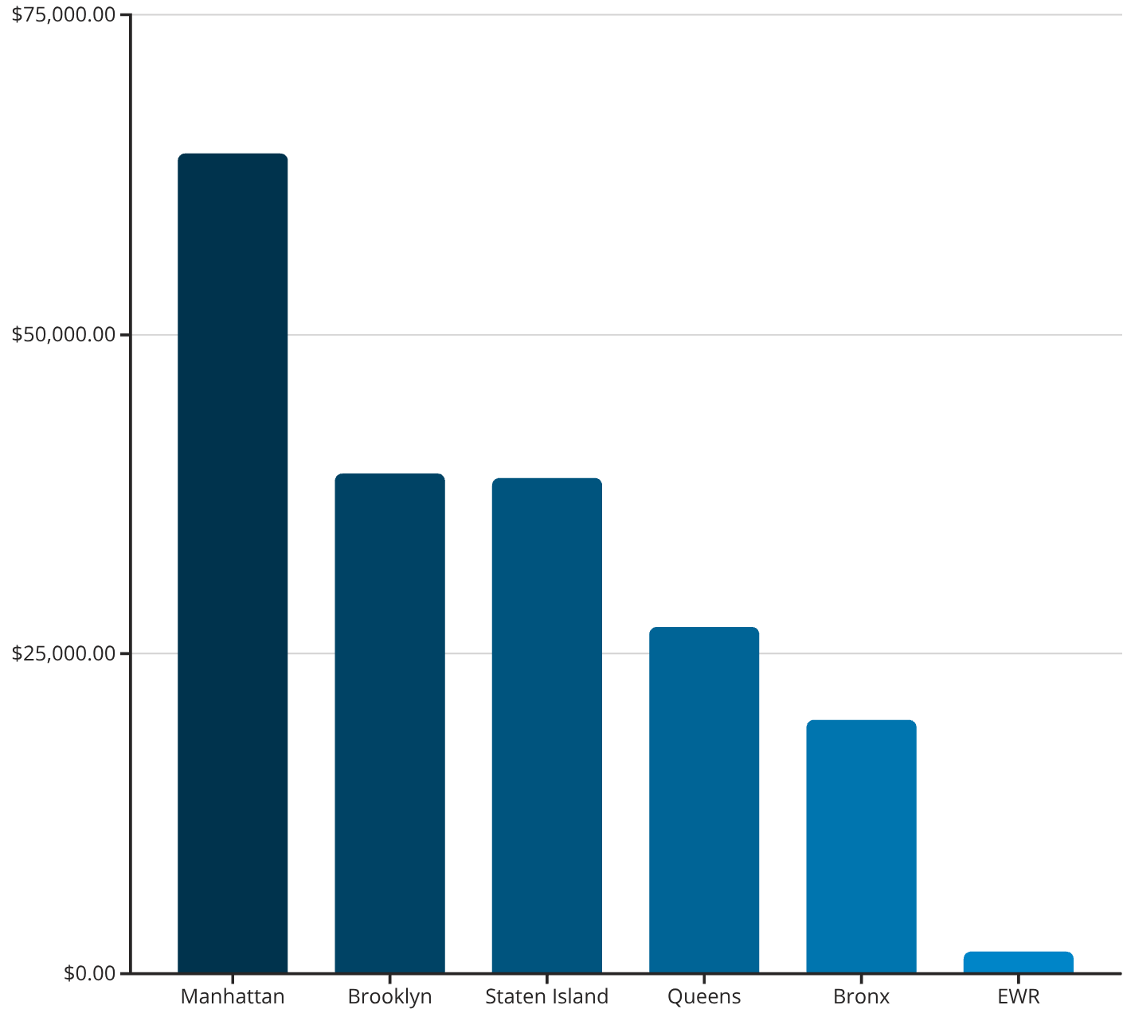
Staten Island Trip Revenue Analysis
Borough-Level Patterns
Manhattan is by far the most valuable destination for trips starting in Staten Island — bringing in $64,179 in revenue, significantly more than Brooklyn ($39,128) or Staten Island itself ($38,786). This means commuters and workers travelling into Manhattan generate the strongest earning potential for drivers.
Top 10 Drop-off Zones by Revenue
Drop-off Zone
Borough
Revenue
Sheepshead Bay
Brooklyn
$13,842
Revenue by Drop-off Borough for Staten Island Pickups (2022)
Arden Heights
Staten Island
$13,713
East Harlem South
Manhattan
$13,199
Kew Gardens Hills
Queens
$7,051
Flatiron
Manhattan
$6,797
TriBeCa/Civic Centre
Manhattan
$6,785
East Harlem North
Manhattan
$6,726
Canarsie
Brooklyn
$6,551
Lenox Hill East
Manhattan
$5,312
Highbridge
Bronx
$4,944
At zone level, areas like Sheepshead Bay in Brooklyn and Arden Heights in Staten Island stand out with surprisingly high revenue, even though they don't have a huge number of trips.

Slide 5

Quarterly Tipping Patterns
Q1 (Apr–Jun): $981 in total tips
Q2 (Jul–Sep): $1,045 in total tips (highest)
Spring/early summer period with moderate to strong tipping activity as weather improves and travel increases.
Highest tipping period in the dataset, reflecting summer peak travel patterns and strong discretionary spending.
Q3 (Oct–Dec): $828 in total tips
Q4 (Jan–Mar): $807 in total tips
Data quality issue: December contains only 57 rows, meaning Q3 effectively reflects only October and November. This period represents the fall/early winter season.
Winter period showing moderate activity, influenced by seasonal weather patterns and holiday travel.
Critical Note: The Q2 peak is misleading due to the incomplete Q3 dataset. Operational planning should account for this data limitation when forecasting seasonal demand.

Slide 6

Top Tipping Staten Island Pickup Zones (Q2)
Only three zones exceeded $100 in tips during Q2, revealing concentrated tipping behaviour in specific neighbourhoods.
$136
$112
$104
Heartland Village/Todt Hill
Bloomfield/Emerson Hill
South Beach/Dongan Hills
Highest total tips — affluent residential area with premium service expectations
Second-highest tips — established neighbourhood with steady demand
Strong coastal zone performance — tourism and local activity combined
While these zones show concentrated tipping behaviour, a full assessment of their value requires understanding trip volumes in each area. High tips combined with high trip frequency would indicate true priority deployment areas.

Slide 7
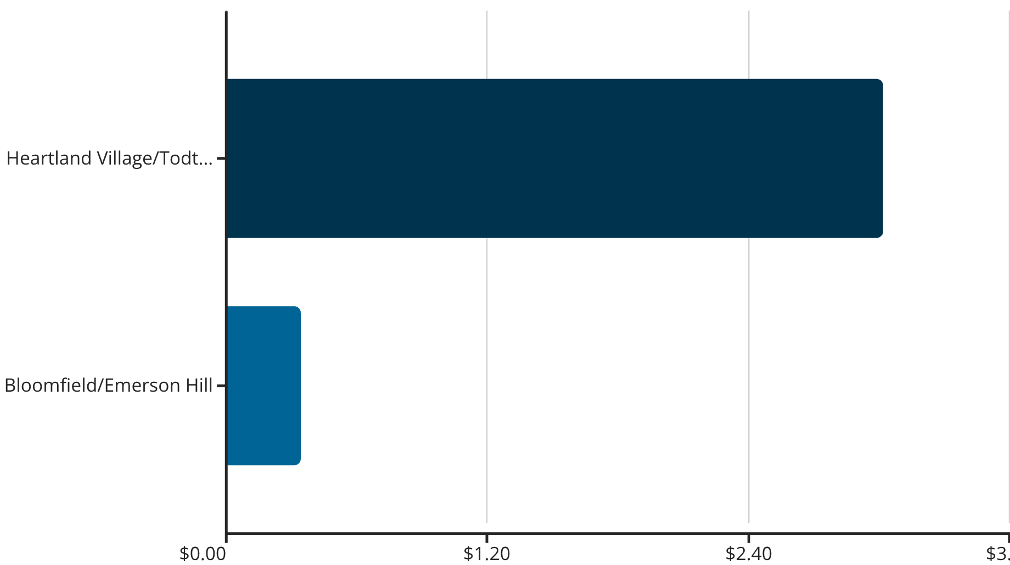
Tip Efficiency: Revenue Per Trip Analysis
Tip Efficiency Comparison
Heartland Village/Todt Hill stands out clearly as the most tip-efficient zone with approximately $3 per trip — almost 9 times higher than Bloomfield/Emerson Hill.
This exceptional efficiency (£136 total tips from just 45 trips) makes it the single most valuable pickup location for maximising driver earnings per journey.
Pickup Zone
Total Tips
Trip Count
Avg Tip/Trip
Heartland Village/Todt Hill
$136
45
$3.02
Bloomfield/Emerson Hill
$112
327
$0.34

Slide 8
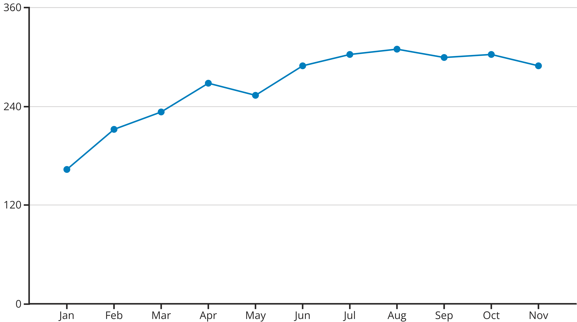
Monthly Trip Volume Trends Throughout 2022
Trip volumes rise steadily from January and stay consistently high
between June and October, with a small dip in September.
Demand peaks in August, representing the optimal month for
revenue generation.
This seasonal pattern suggests fleet capacity and driver
scheduling should be optimised for summer months,
with August requiring maximum resource allocation
to meet peak demand effectively.
Jan–Mar
1
Gradual recovery from winter lows as weather improves
2
Apr–May
Spring acceleration with rising tourist and commuter activity
Jun–Aug
3
Peak summer demand with August reaching highest volumes
4
Sep–Oct
Sustained high demand with minor September dip
Nov–Dec
5
Year-end patterns (incomplete data limits full analysis)

Slide 9
Top 3 Revenue Optimisation Insights
1. Prioritise Manhattan-Bound Trips
2. Optimise for Summer Peak
3. Target High-Efficiency Zones
Most revenue comes from Staten Island trips going into Manhattan. These long, high-value journeys should be prioritised when allocating driver availability.
Summer (Q2), and potentially Autumn (Q3), are the strongest seasons for tipping and revenue generation.
High tip-efficiency zones such as Heartland Village/Todt Hill generate exceptional revenue per trip — up to $3 per journey.
Shift patterns, pricing strategies, and fleet deployment should be optimised during these quarters to maximise earnings during peak demand periods.
Supply should be allocated strategically to these areas, particularly during Q2 and Q3, to maximise driver earnings and overall fleet profitability.
Once drivers arrive in Manhattan — the borough with the highest revenue potential — their opportunities for additional fares increase substantially, creating a multiplier effect on earnings.

